Slide 1
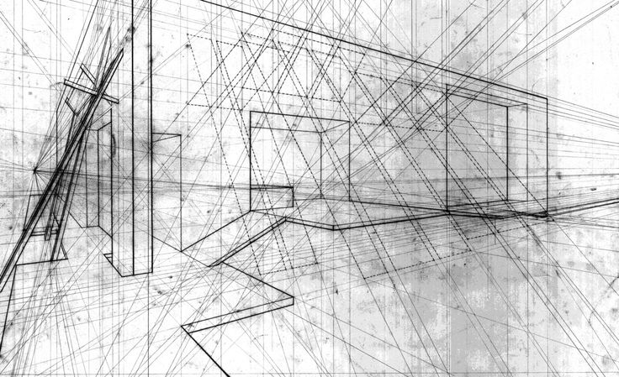
level design
ITU, Spring 2017
Hajo Backe

Slide 2


Slide 3

underlying principles

Slide 4
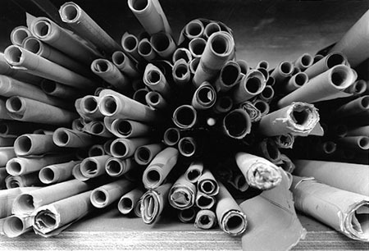
Situations of Play (McGregor 2007)
Game space directly challenges player – Forms gameplay
Game space as arena for conflict – Affects gameplay
Game space structured by social layout – Structures gameplay
Game space as interface & information – Contains information in gameplay
Game space is created & altered – Becomes gameplay
Game space as non-interactive – Not part of gameplay
Challenge space
Contested Space
Nodal Space
Codified Space
Creation Space
Backdrops
= patterns embedded in real space that manifest as archetypes of spatial use in game space
Notes:
Challenge Space: where the environment directly challenges the player
Contested Space: where the environment is a setting for contests between entities
Nodal Space: where social patterns of spatial usage are imposed on the game environment to add structure and readability to the game
Codified Space: where elements of game space represent other non-spatial game components
Creation Space: where the player constructs all or part of game space as part of gameplay
Backdrops: where there is no direct interaction between the game space and the player

Slide 5
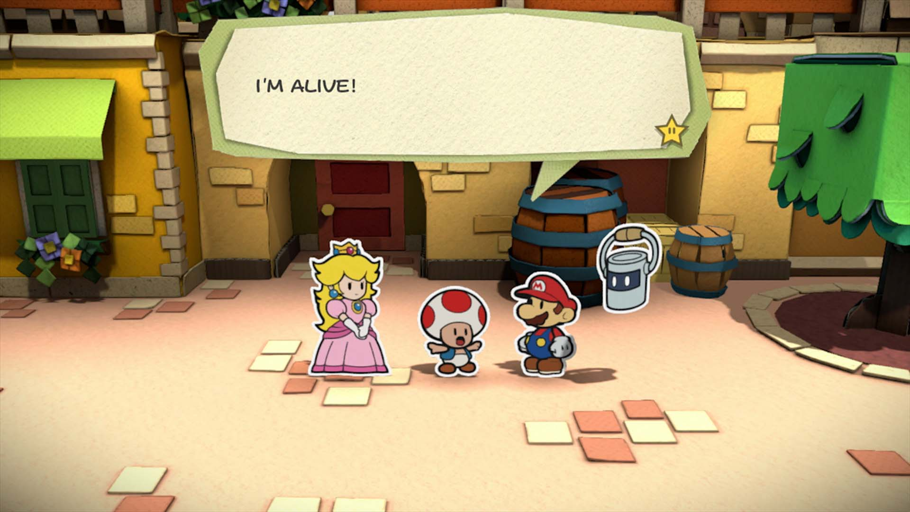
Cardinality and Representation
Fernandez-Vara/Zagal/Mateas (2005):
Cardinality of gameplay: freedom of movement
Cardinality of gameworld: the way in which the player can navigate the space
Spatial representation: two or three dimensions, independent from freedom of movement or navigation; greater or equal than cardinality

Slide 6
Cardinality of gameplay
“the degree of freedom the player has with respect to the control of movement in a game.”
defined by the number of axes that the player can use to move entities around. (X, Y, Z), i.e. side to side, up and down, back and forth.
Only movements the player can perform, not actions (e.g. shooting)

Slide 7
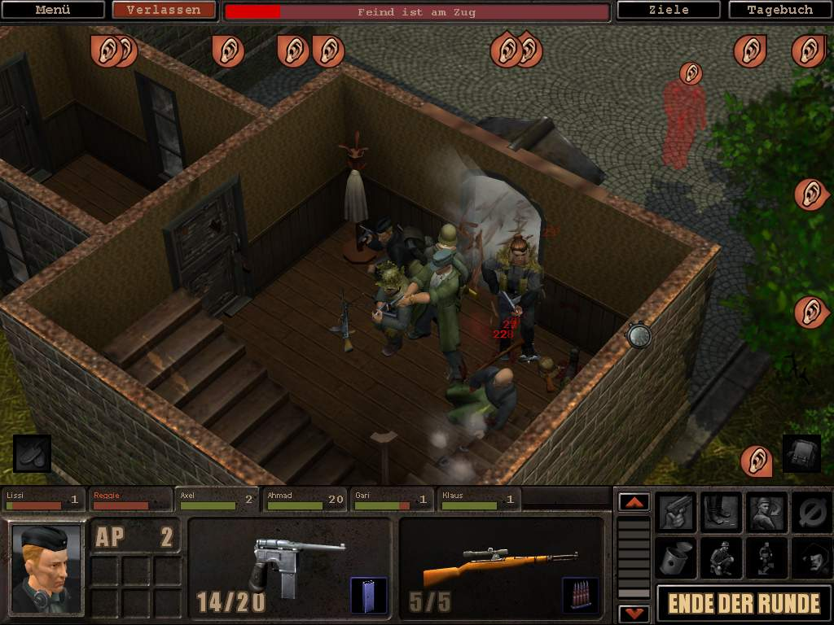
what do we even mean by ‘level’?

Slide 8
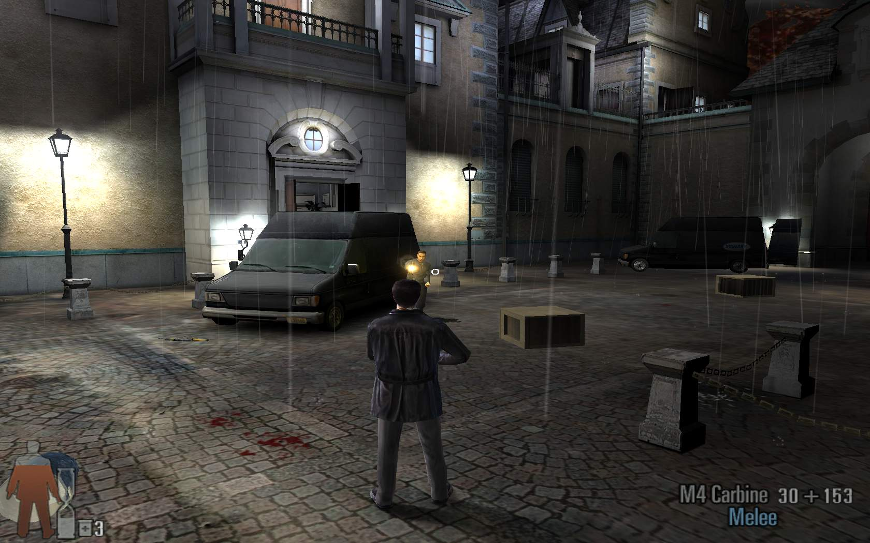
what do we even mean by ‘level’?

Slide 9
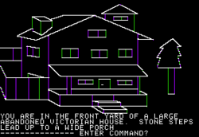
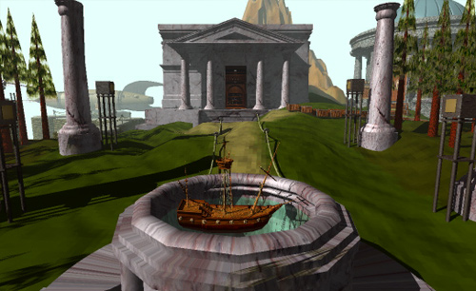
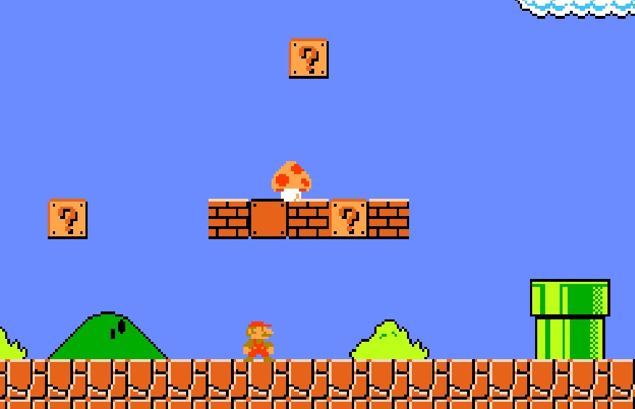
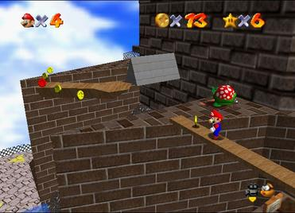
what do we even mean by ‘level’?

Slide 10
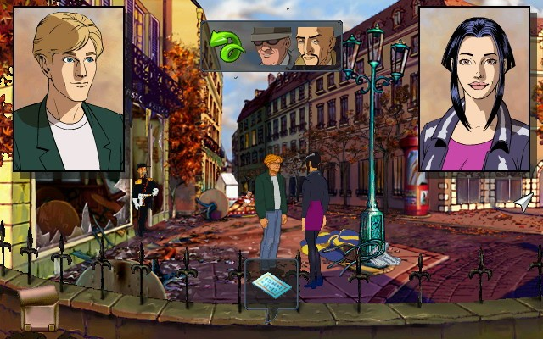
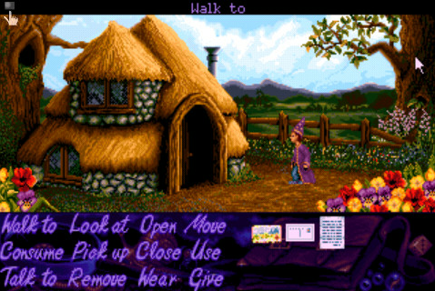
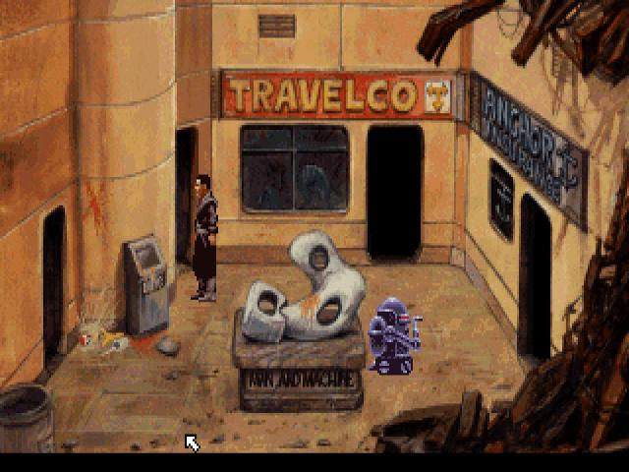
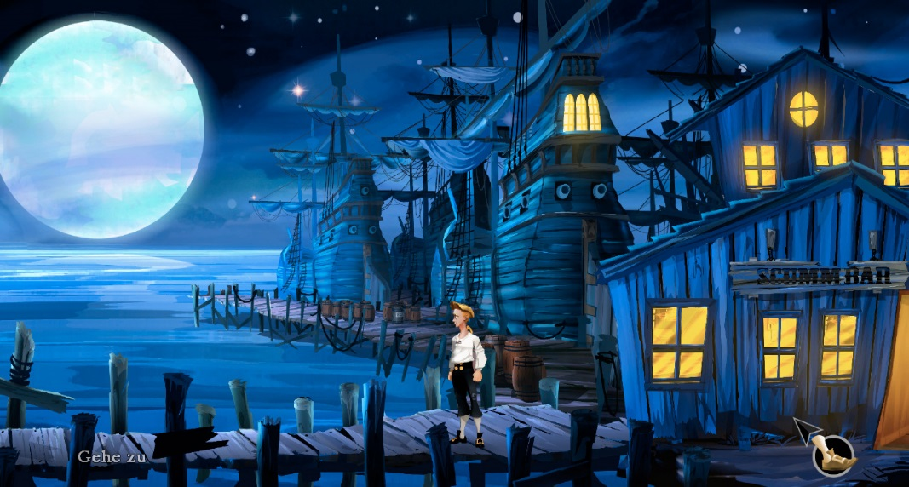
world as environment and sign

Slide 11

Another World-Design

Slide 12
The Theme Park Ride

Slide 13
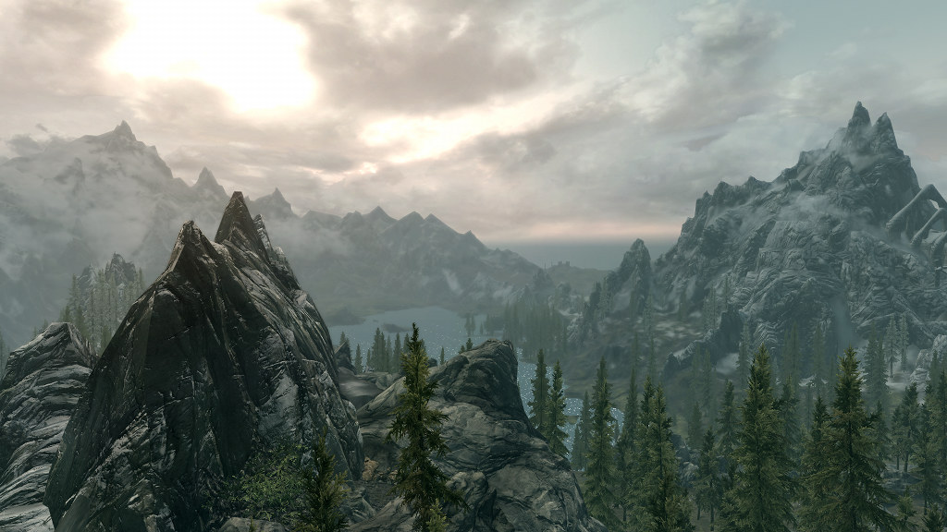
beautiful nature

Slide 14
beautiful architecture

Slide 15
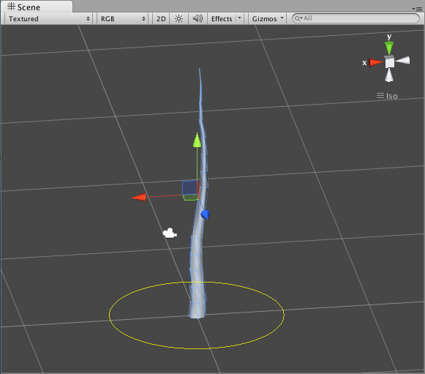
there is only architecture in games!

Slide 16
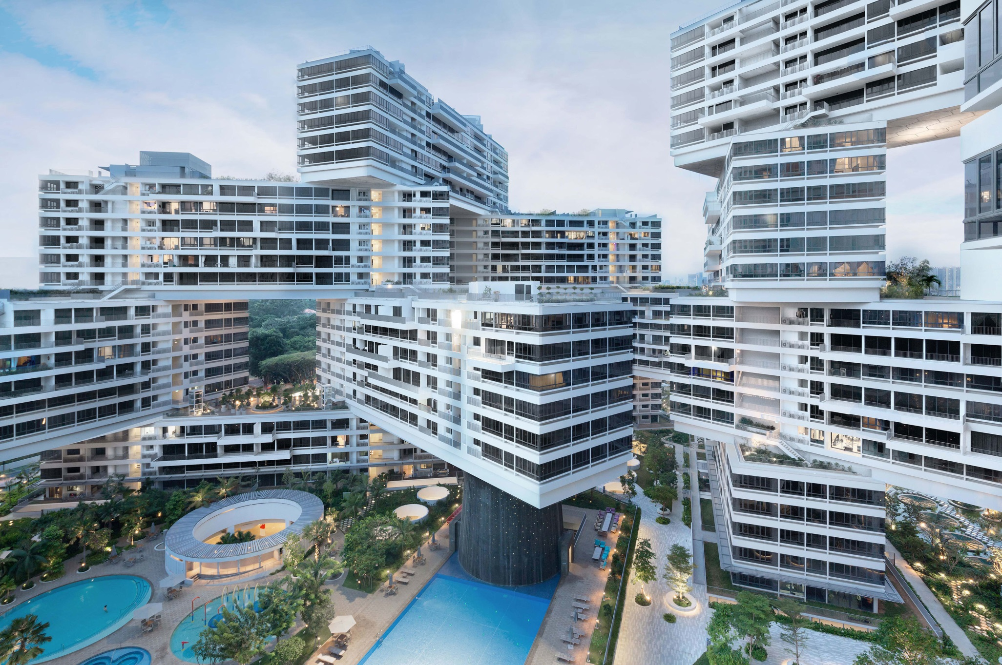
Space and Architecture
“Videogames are spatial constructs and the environments of videogames architectural.” (McGregor 2007)
Architecture: Physical constructs and the activities that occur within them, including social interaction
Architecture guides and suggests, affords or impedes activity, i.e. has a close relationship with behavioral patterns , carries meaning, refers to structure and organization
Architecture = a cultural artefact

Slide 17
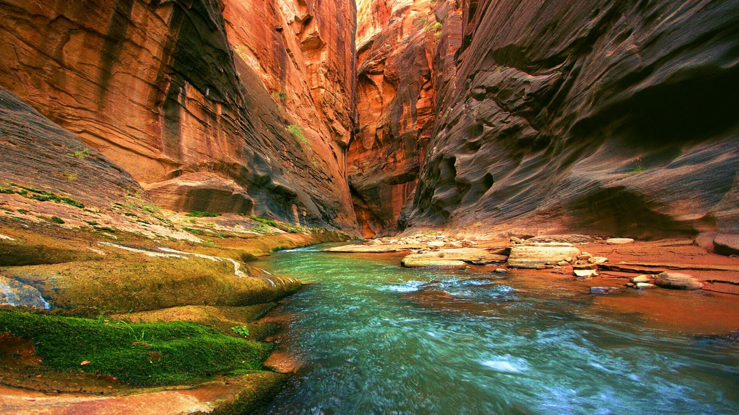
Wolf: 5 layers
Nature
Culture
Language
Mythology
Philosophy

Slide 18
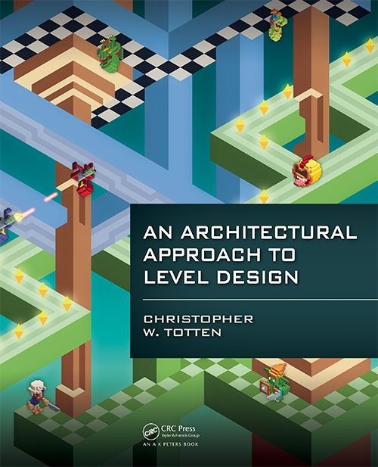
One approach
Level Design through Architecture

Slide 19
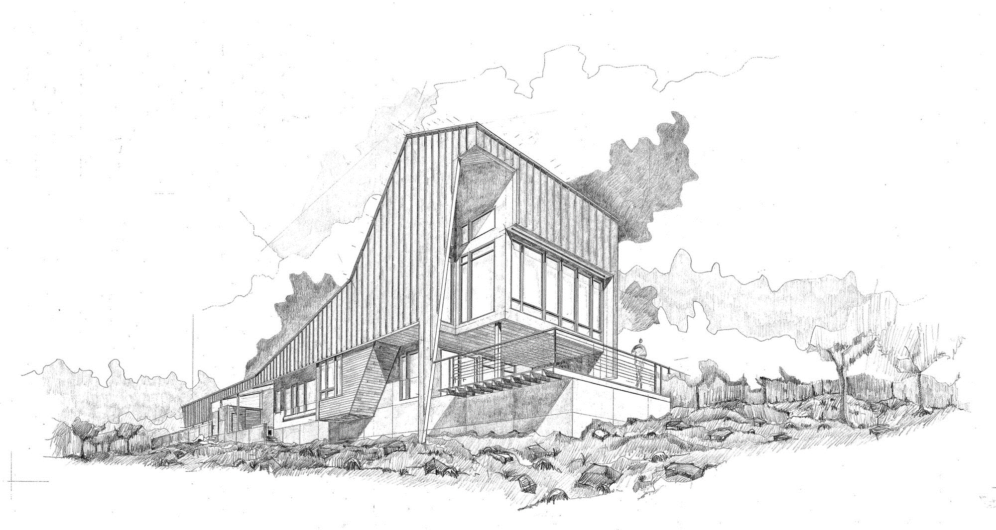
Four Trajectories
possibility vs. constraint
refuge vs. reward
single- vs. multiple-use
visual rhythm

Slide 20
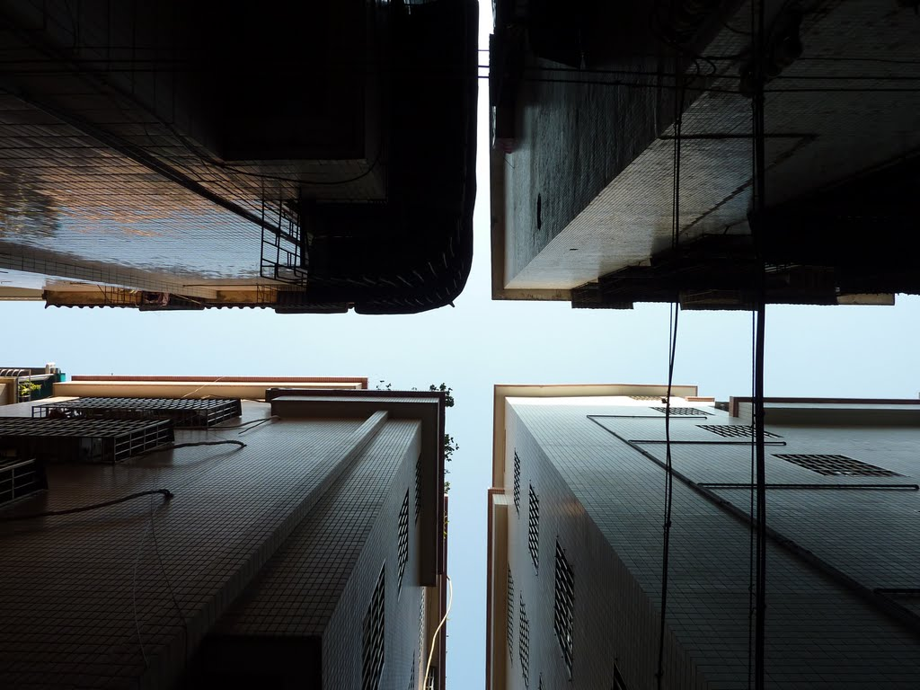
possibility vs. constraint

Slide 21
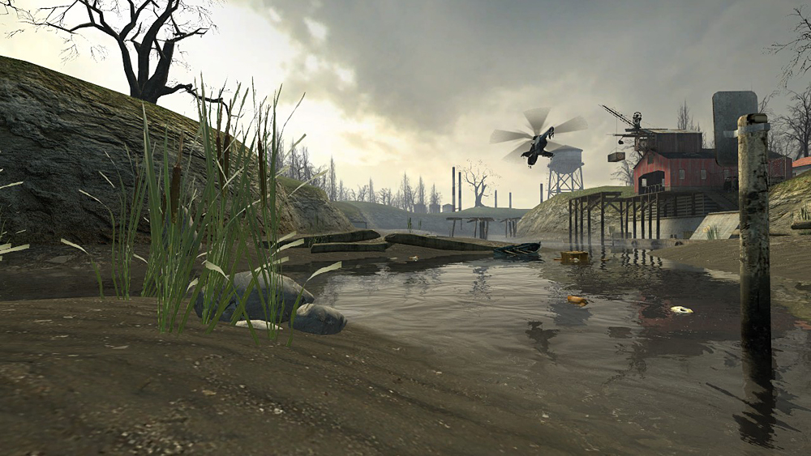
few possibilities in a corridor

Slide 22
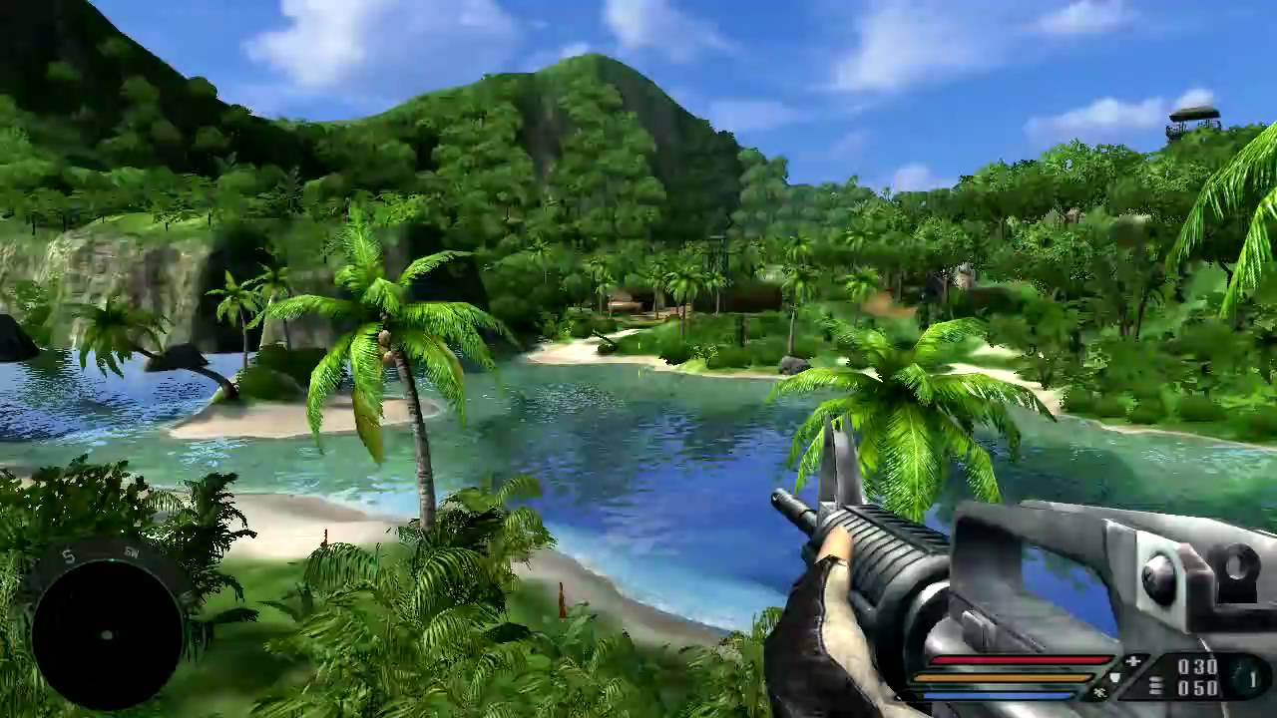
some possibilities in an arena

Slide 23
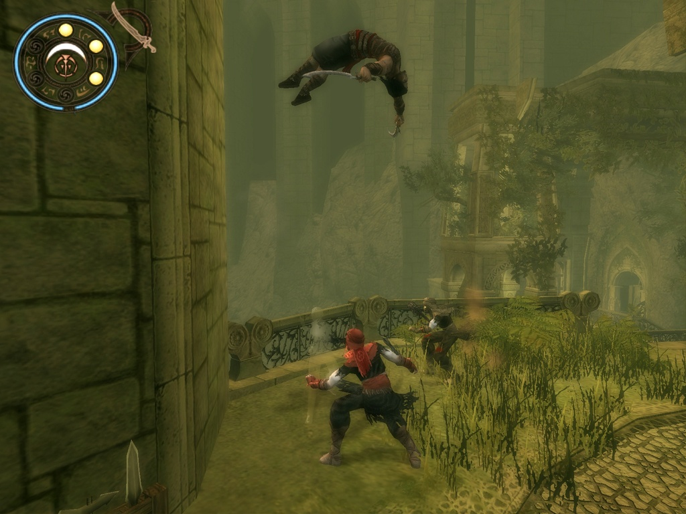
possibilities aligned with space

Slide 24
game space logic
freedom/restriction
cardinalities of action
movement
events
activities
visualization
gaze
macro-organization
integration

Slide 25
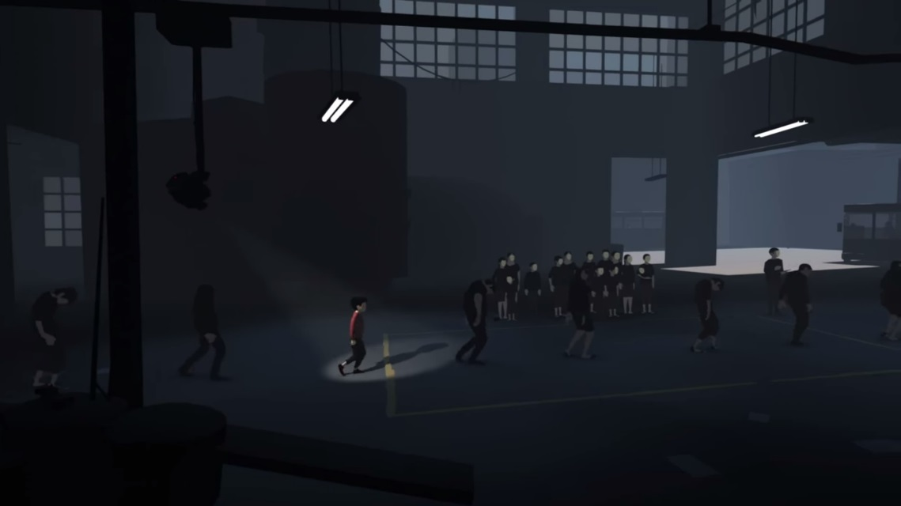
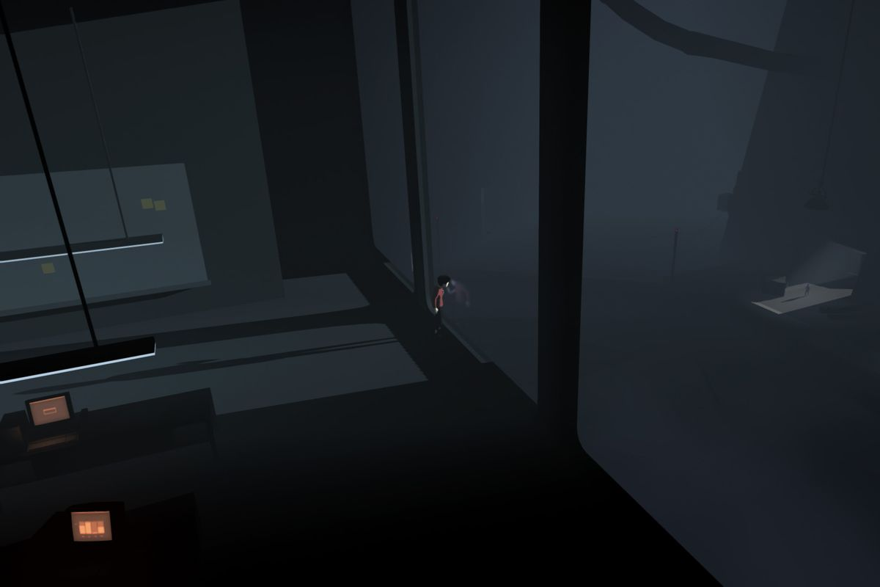
visualizations and gazes

Slide 26
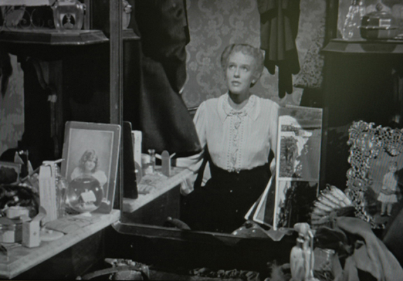
Framing: what’s not in the shot

Slide 27
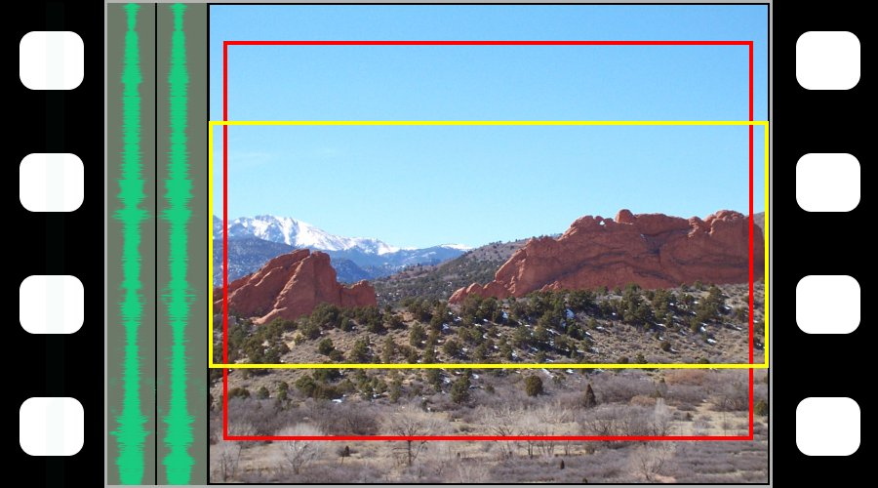
Aspect Ratios

Slide 28
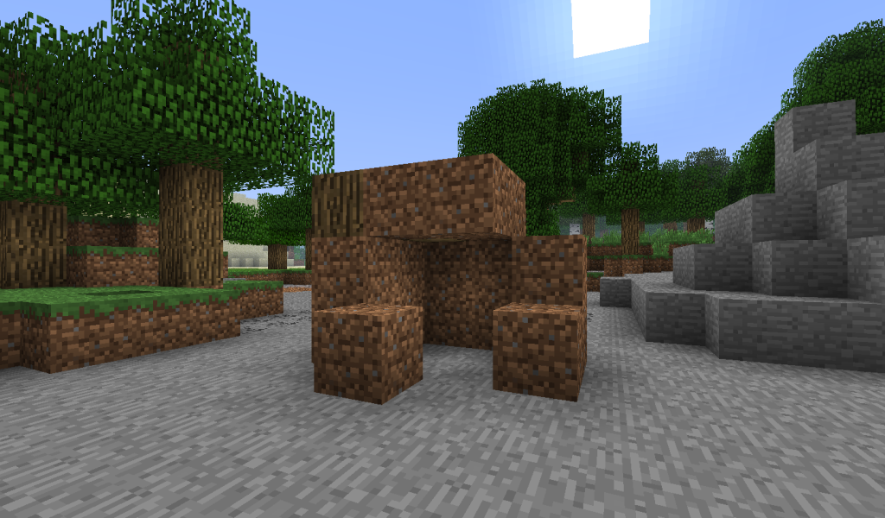
refuge vs. reward

Slide 29
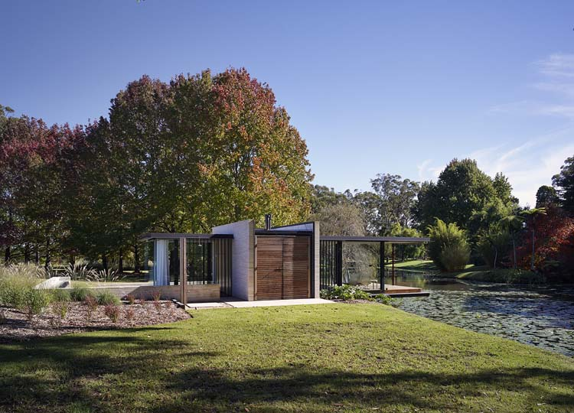
prospect-refuge-theory

Slide 30
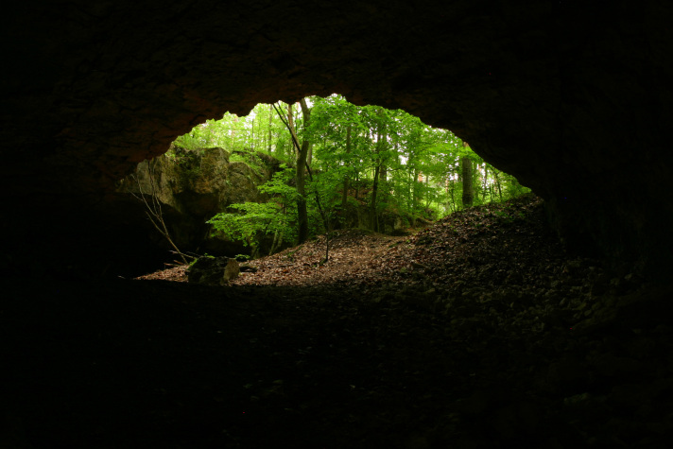
guiding through rewards

Slide 31
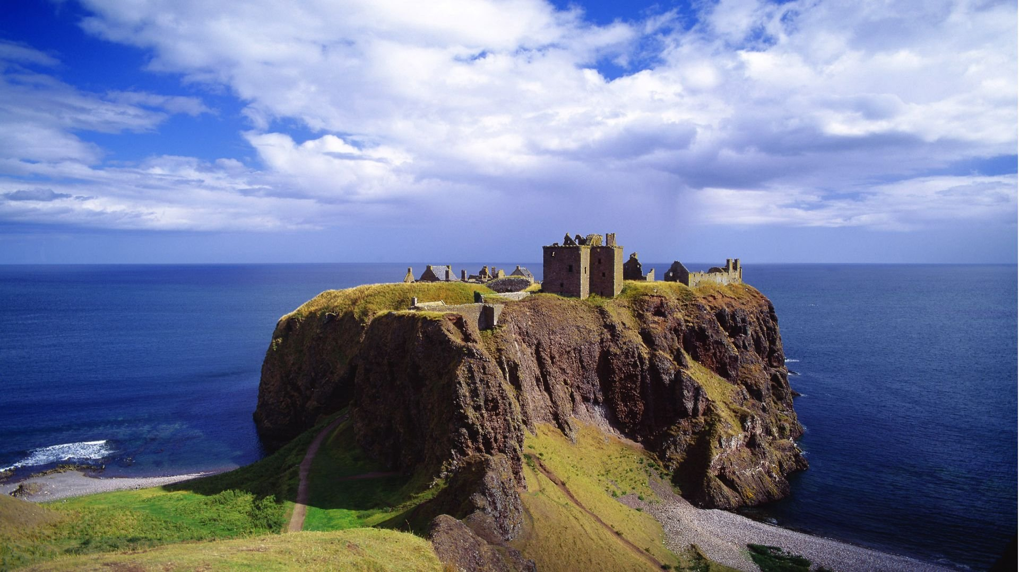
Reward Spaces
Reward vaults
Rewarding vistas
Meditative space
Narrative stages

Slide 32
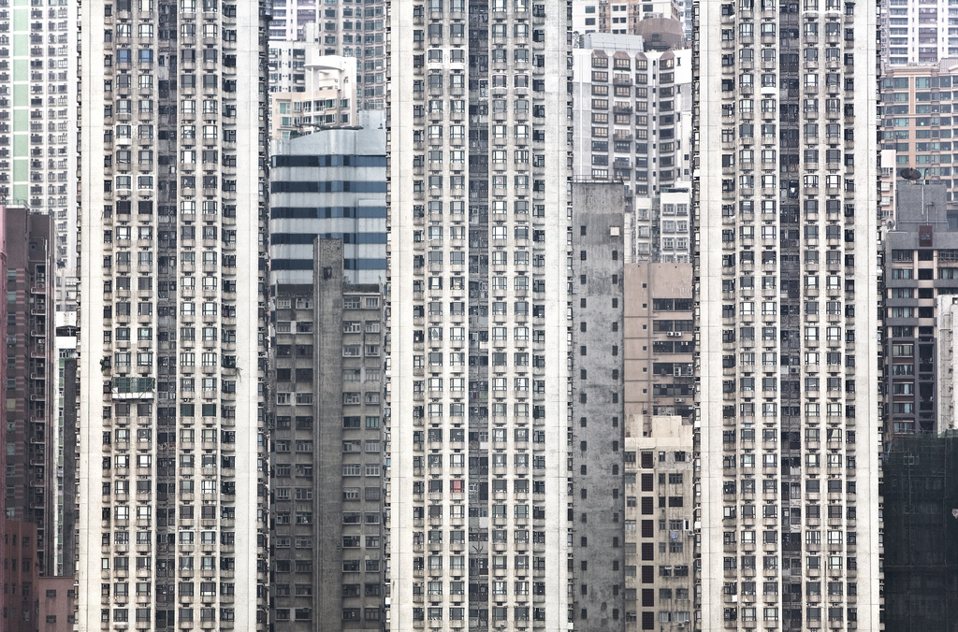
single vs. multi-use

Slide 33
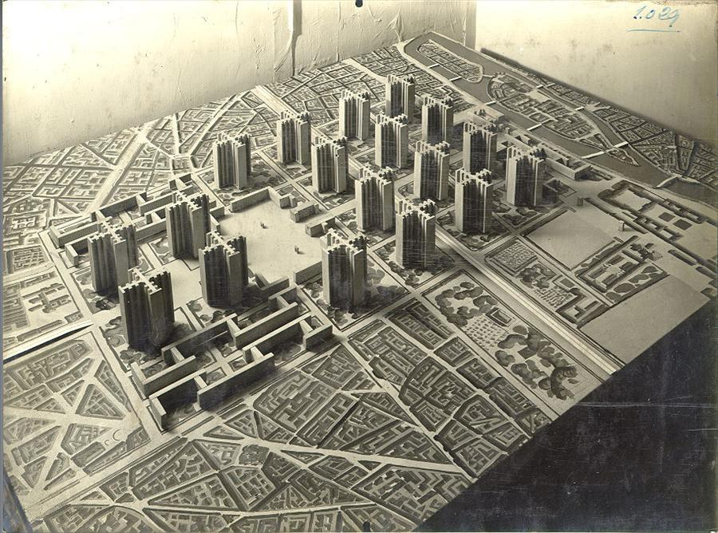
Urban Design and Diversity
Diverse Urban Design …
… applied to game spaces
1. Multiuse districts that encourage constant use by people
2. Short blocks to allow easy access to amenities and exploration
3. Buildings of varying age so as to vary economic factors
4. Density of population
1. Multiuse gamespaces with access to a variety of mechanics (shopping, talking, fighting, recharging, etc.)
2. Close proximity of functional spaces to one another
3. Spaces for players of different styles, types, or factions
4. Accommodation of player density

Slide 34

visual rhythm

Slide 35

vistas and resonances

Slide 36
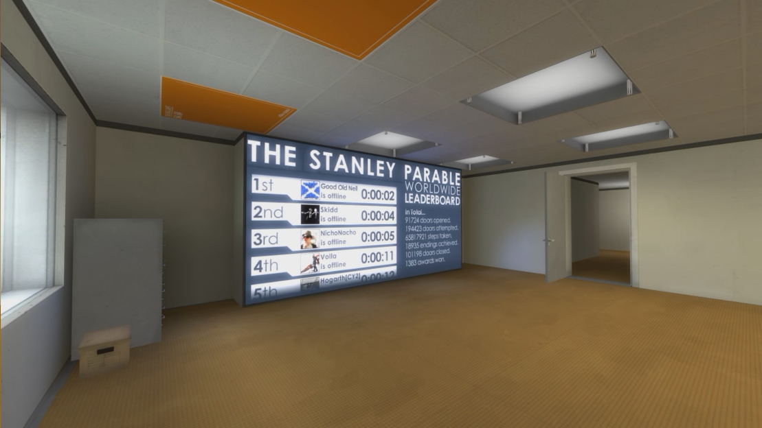
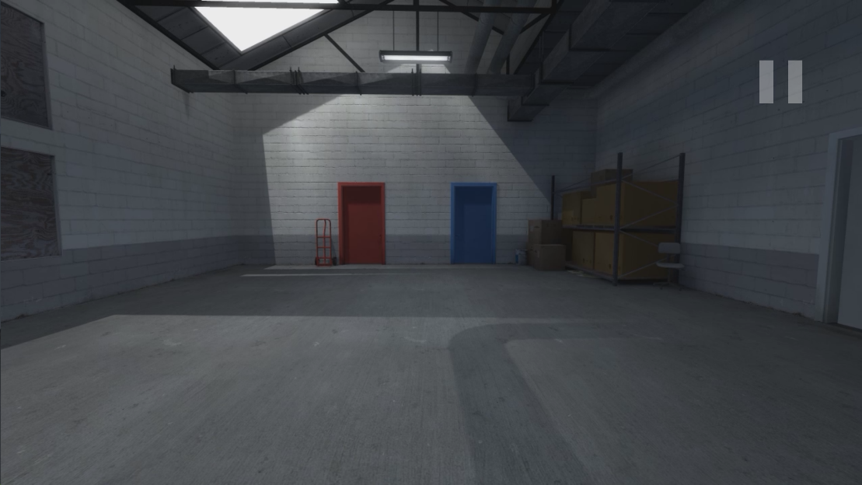
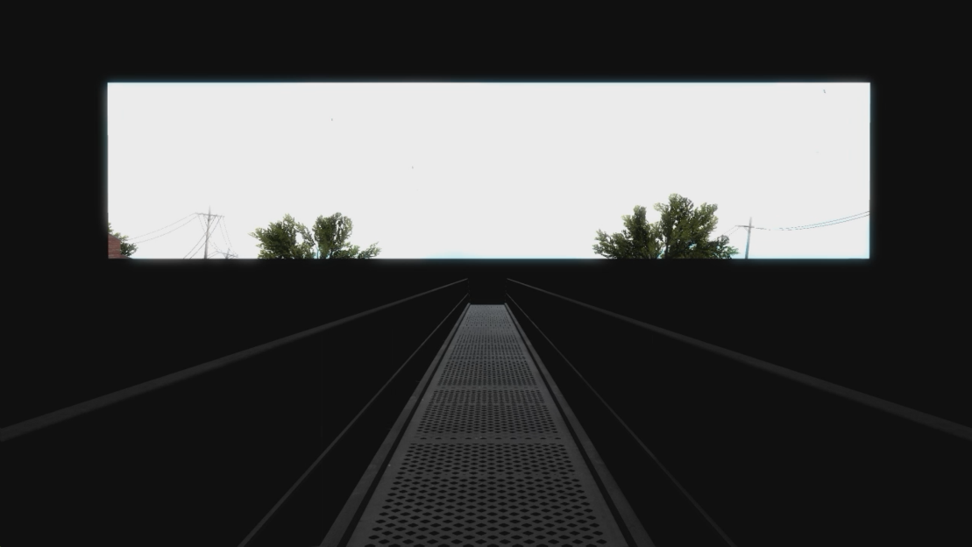
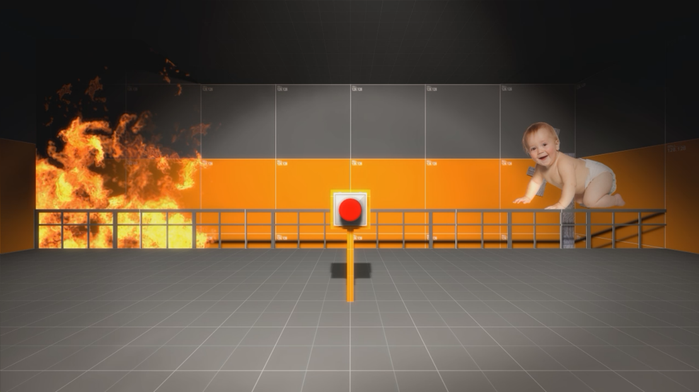
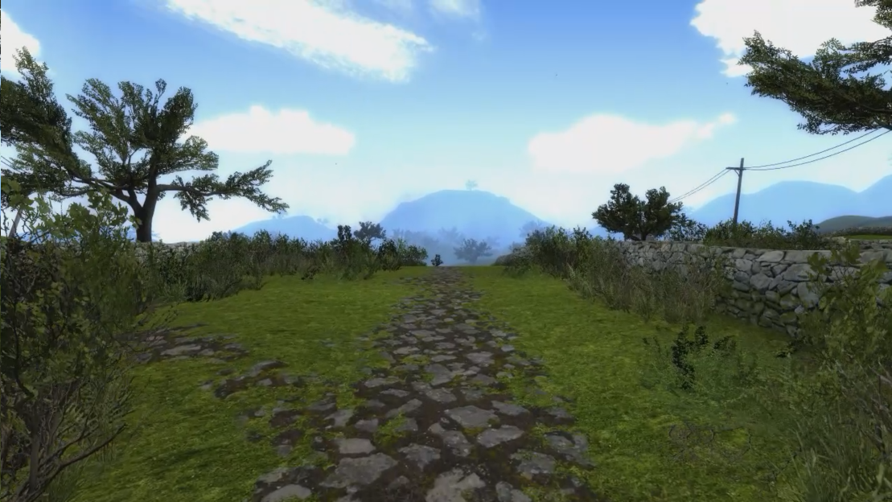
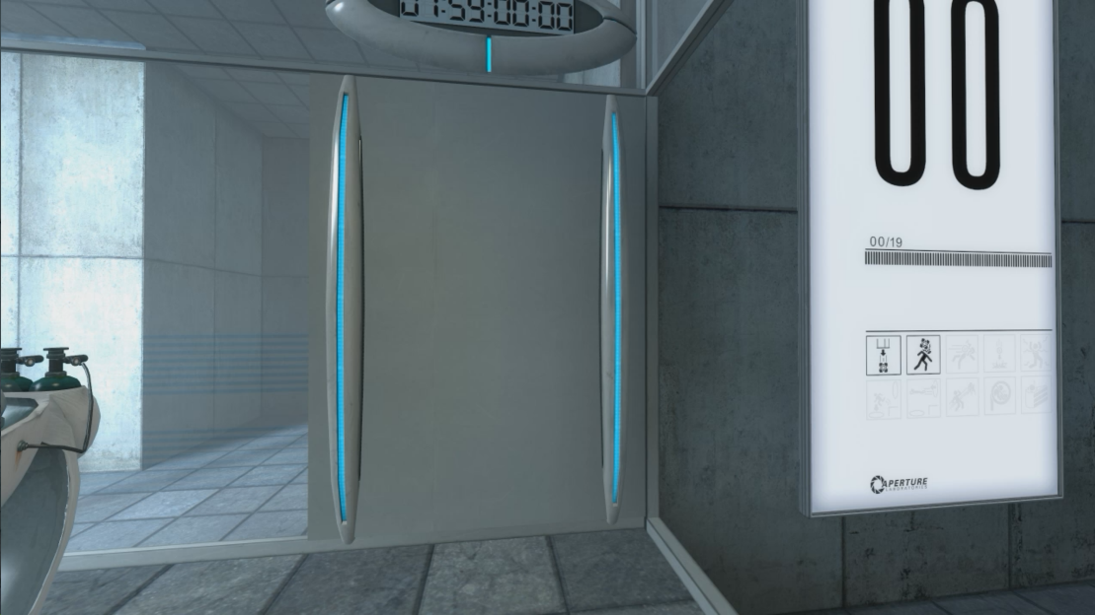
The Stanley Floor Collection

Slide 37
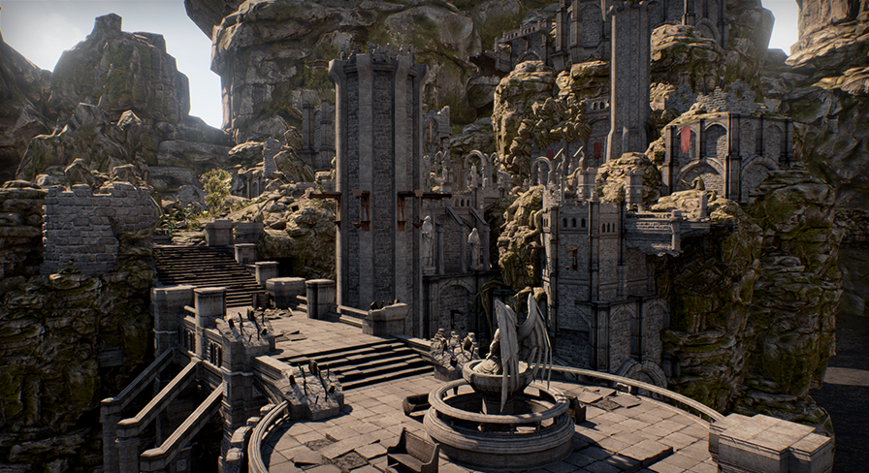
Totten: Think like an Architect
Identify what gameplay occurs in the space. What are the game mechanics supported?
Look up as you walk around, noticing visual elements, especially art that contrasts the rest of the environment or somehow calls attention to itself. Also look down—is the space’s verticality used in reverse to make you feel in danger?
Sense the space by its size, shape, and how it interacts with light, sound, and other spaces. How do the lighting or sound conditions make you feel?
Analyze the pacing of the level. Does the level usher you through itself quickly, or are there opportunities to explore? Are these required or bonuses for extra curiosity?
Is there one gameplay style reflected in this level, or are multiple supported? (For example, does a deathmatch map have places for snipers, offensive players, defensive players, etc.? Does a game level play well for barbarians but poorly for mages?)
How does the space express the narrative of the game? Is it a backdrop, or does exploring the level tell you about the game world in some way? Are narrative events scripted to occur around the player,or are there cutscenes?
Examine any historical or gameplay precedents. What kinds of spatial experiences were in those games?
Analyze the composition, proportions, and rhythms of environment art elements.
How does level geometry compare with the movement abilities of your avatar? Is everything well within their capabilities, or does the level space challenge these measurements? Is there anything that is outside of these capabilities? If so, does the game offer any way to expand these abilities?
What environment art elements are repeated? Are they interactive? If so, do they correspond to a specific gameplay mechanic?

Slide 38
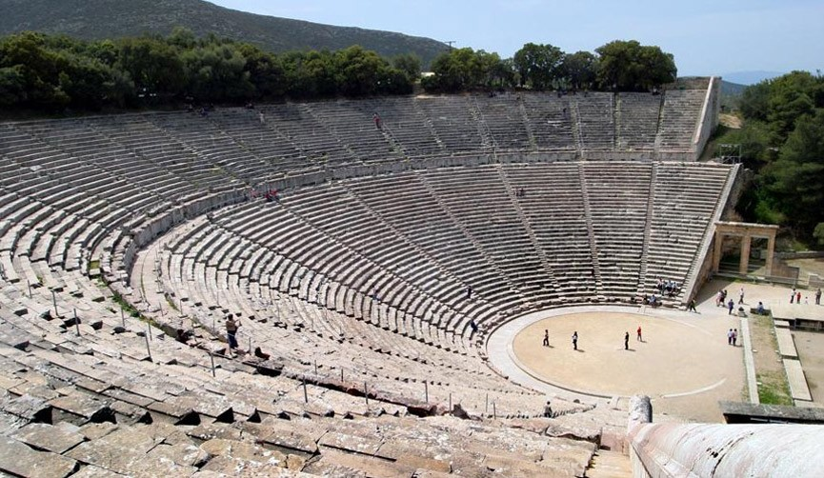
Aural Architecture
intradiegetic
ambiance (falsified space)
cues
dialogue
music
extradiegetic
ambiance (falsified space)
cues
dialogue
music

Slide 39
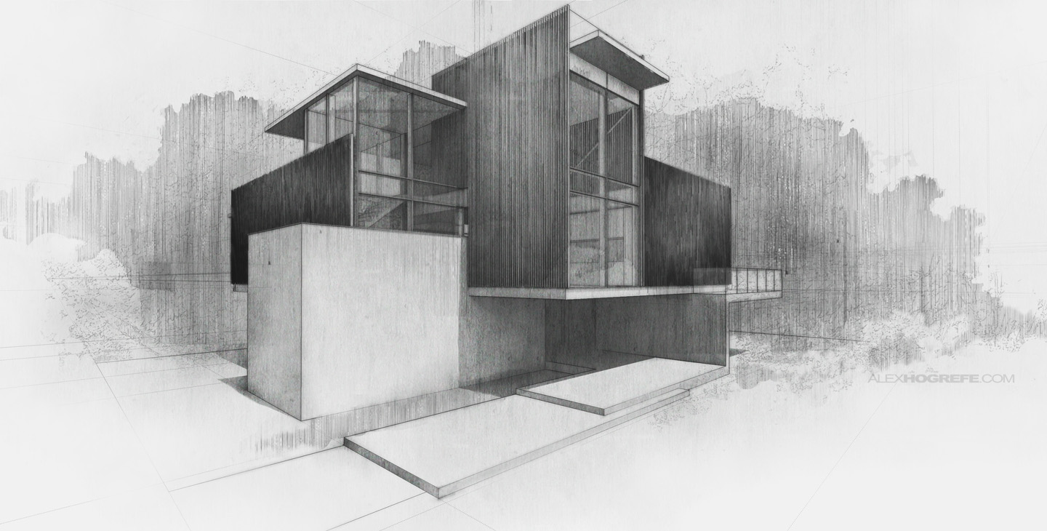
architecture

Slide 40
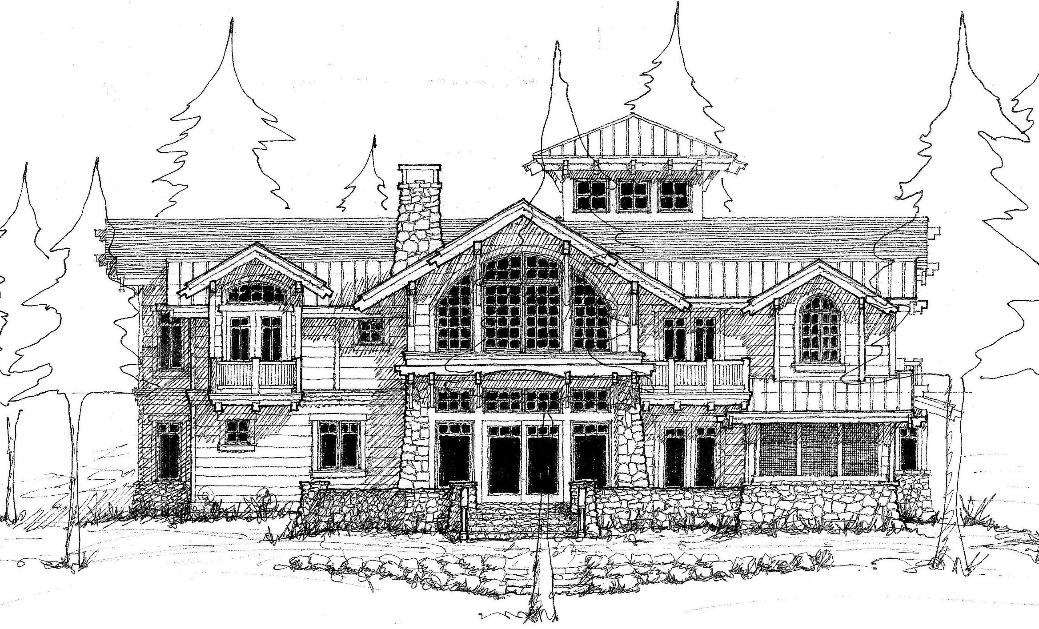

Slide 41
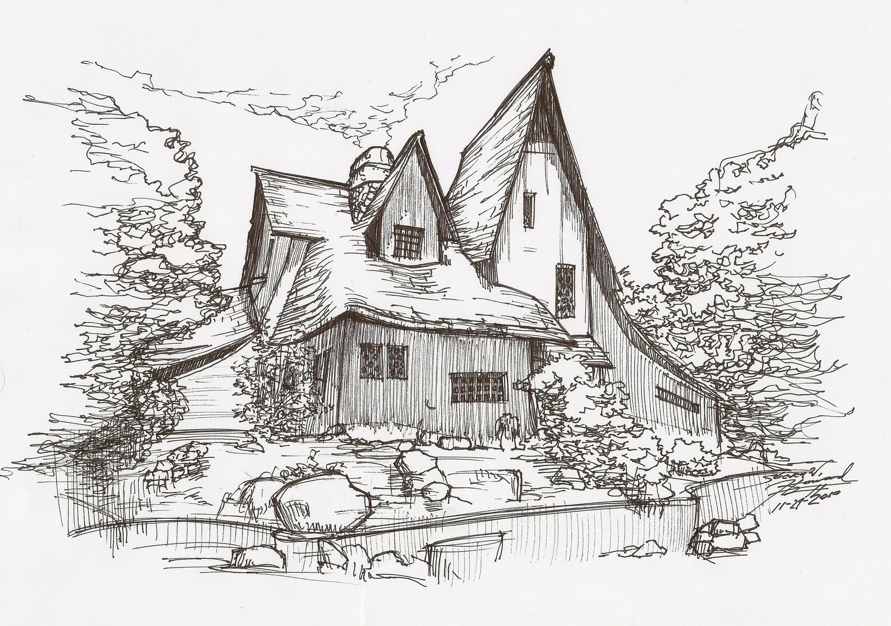

Slide 42
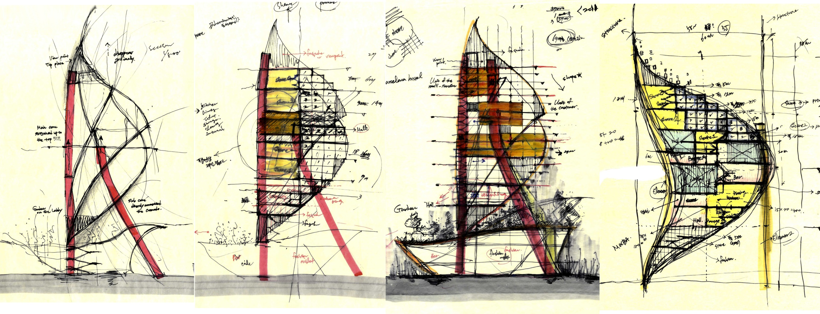

Slide 43
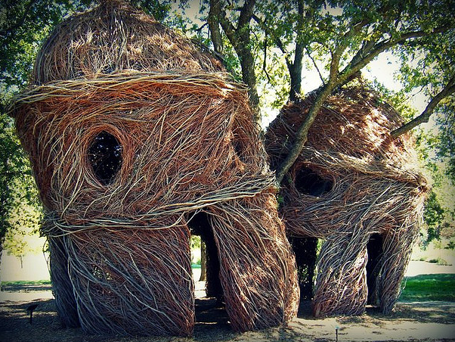
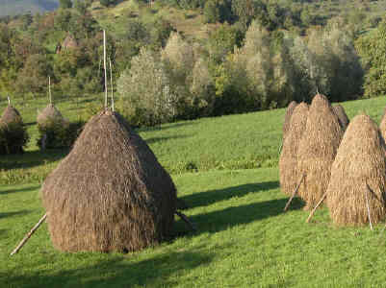
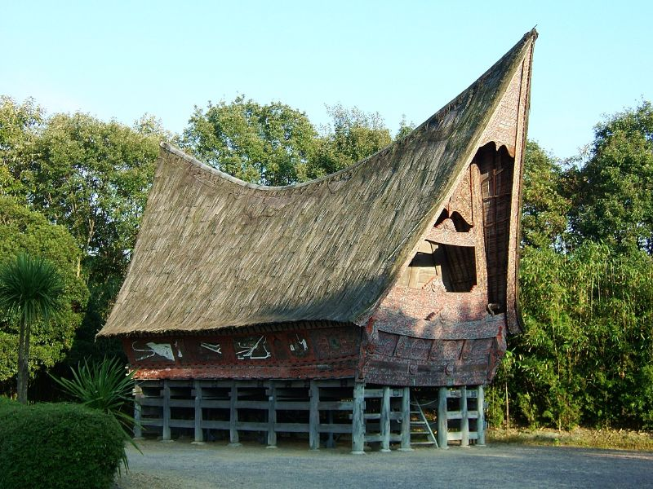
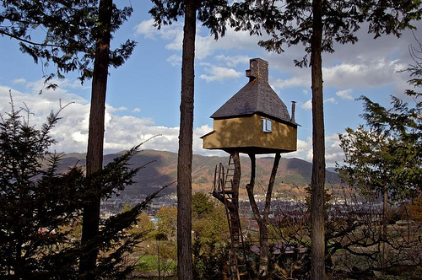

Slide 44
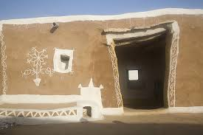




Slide 45


Slide 46


Slide 47


Slide 48


Slide 49




cities

Slide 50



Slide 51


Slide 52


Slide 53


Slide 54


Slide 55



Slide 57


Slide 58


Slide 59



Slide 60


Slide 61



Slide 62


Slide 63

Next Pitch
Focus on
one thing you have managed to fix/implement/adapt since last time
one open question that you want input on
Feedback
concentrates on progress
offer reaction to open question

